Slide 1
JEWELLERY LISTING APPLICATION
PRESENTATION BY, RAHUL KUMAR NAKUL AGARWAL HARSHITHA S
AASTHA RAI MANISH JAISHWAL

Slide 2
INDEX
INTRODUCTION
PROBLEM STATEMENT
TECHNOLOGIES USED
RESULTS
CONCLUSION

Slide 3
INTRODUCTION
The main objective of the project to help customer to find the right piece of jewelry that is simple, elegant or something that will light them up.
This interactive and dynamic website that provides the customer with an on-the-click functionality to search for their desired products.
This application also aims at providing the customers with a quick and easy way to compare the jewellery products being offered.

Slide 4
PROBLEM STATEMENT
This application helps the customer to select his/her desired product in a single click.
From this application the Customer can purchase items from the comfort of their own homes or work place. Shopping is made easier and convenient for the customer through internet.

Slide 5





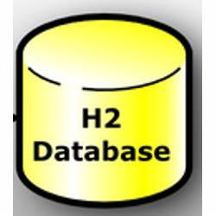
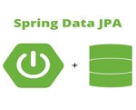



TECHNOLOGIES USED

Slide 6
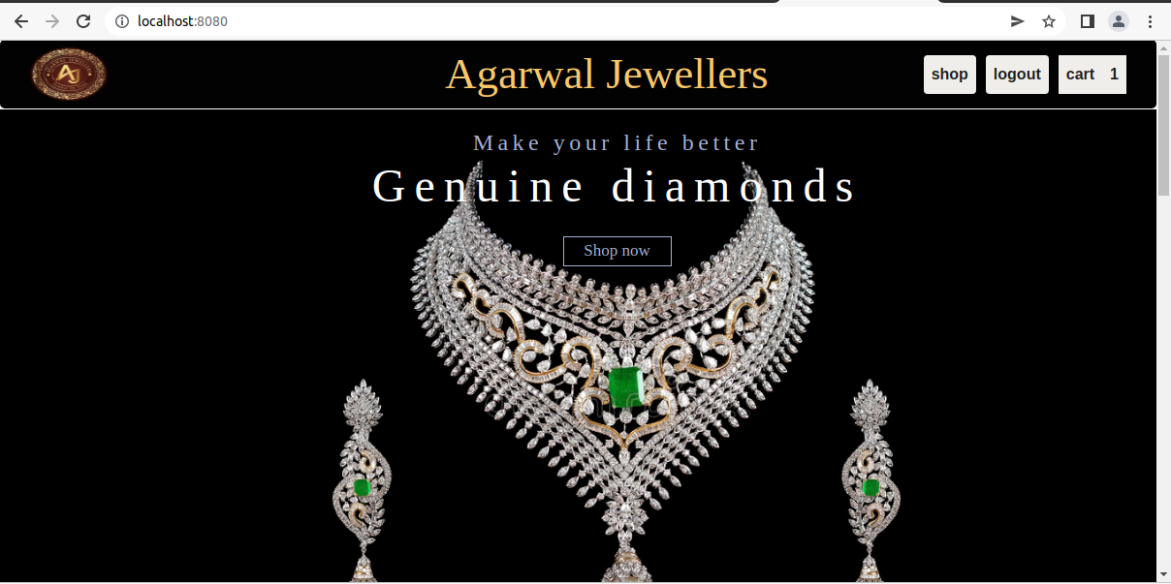
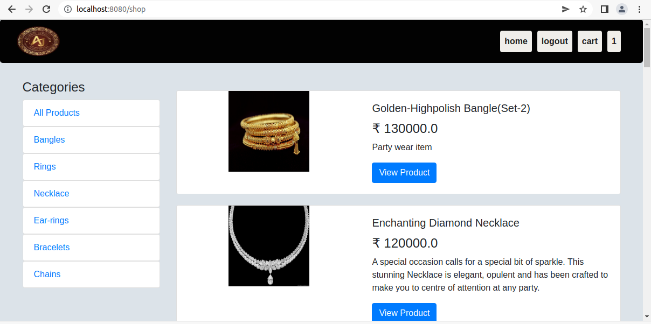
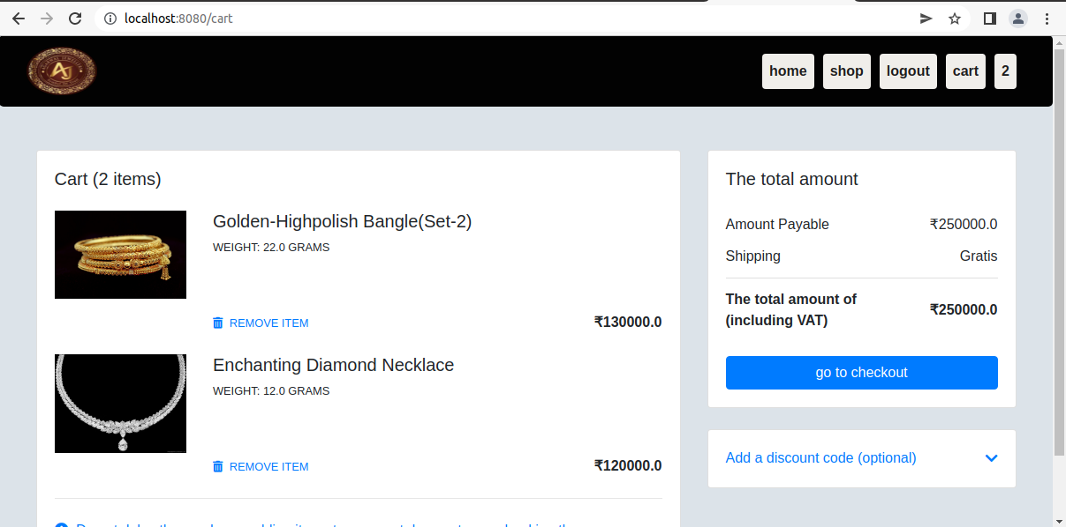
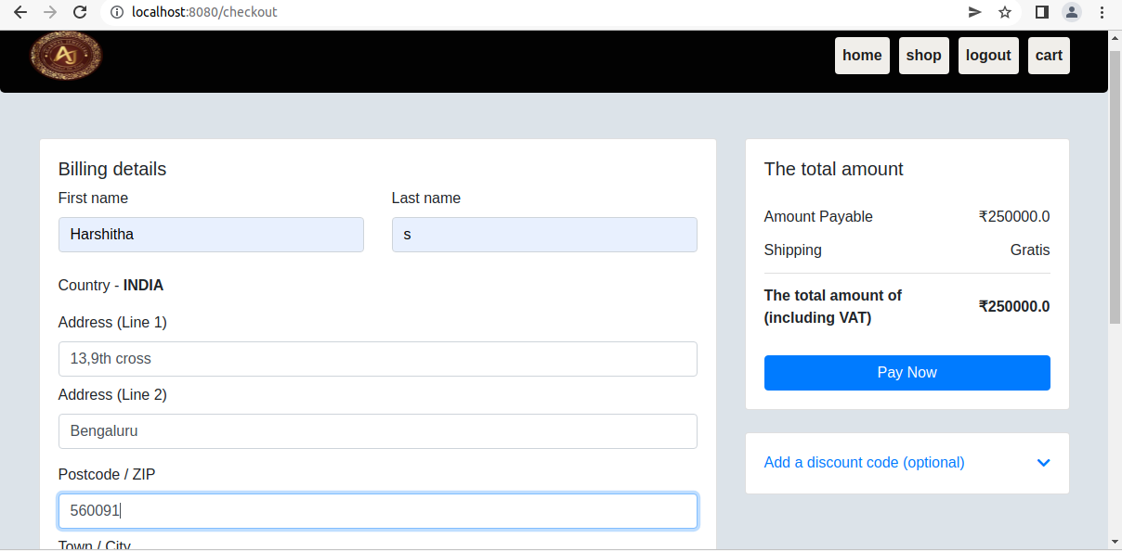
RESULTS

Slide 7
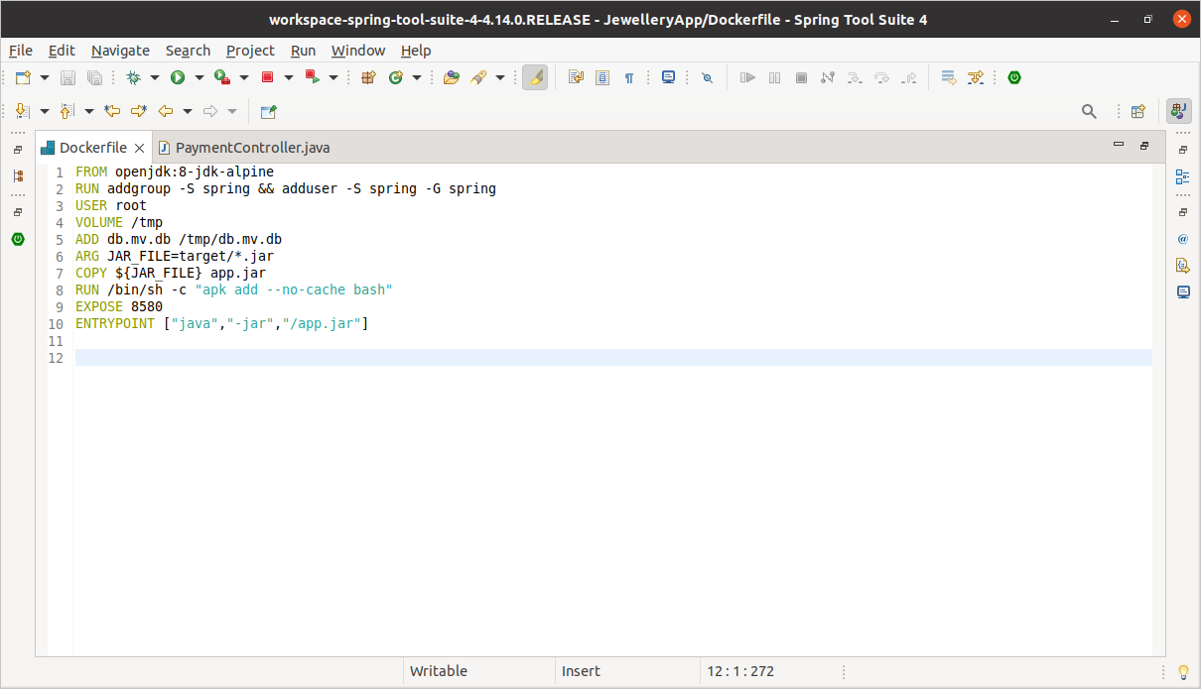

Slide 8





DOCKERS
DOCKER
HUB
DOCKERFILE
ADD
CODE
BUILD
RUN
COMMIT
And
PUSH
DOCKER IMAGE
DOCKER CONTAINER

Slide 9
CONCLUSION
This application provides with the capability to shop for one’s desired products from anywhere in the world in no time thus reducing time , cost and effort factors.
It provides a friendly graphical user interface which proves to be more beneficial and productive compared to the traditional system.
This system has adequate scope for modification in future if it is necessary.

Slide 10
THANK YOU

